Slide 1

The American Work-Life Problem
January 1, 2023
Brett Gordon

Slide 2

Agenda
Census Numbers
Related Data
Troubling Trends
Suggestions
Closing

Slide 3

Introduction
The US Census is collected every 10 years to determine demographic data.
We want to determine what kind of trends we see with this information and how things can improve for the average worker in the future.
Over 30,000 participants in the workforce surveyed

Slide 4
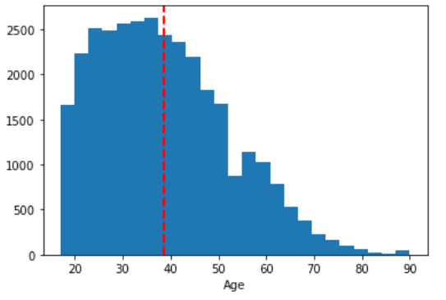
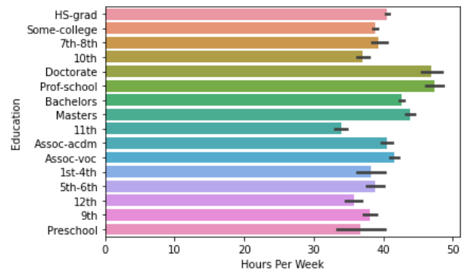
Background Info

Slide 5
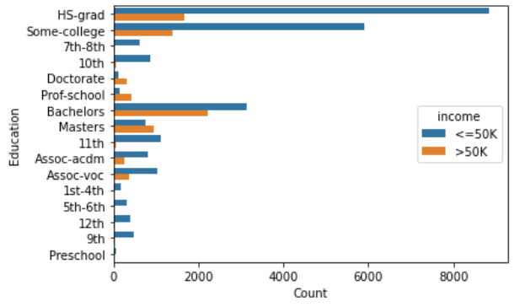
Salary Based Off Education
LARGE DISPARITY
SMALL DISPARITY

Slide 6
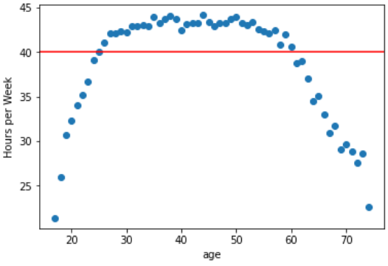
Average Hours Per Week By Age

Slide 7
Income in 1994
Census Sample
Average Annual Pay
Nearly 25k made under $50k
Less than 8k made over $50k
According to State and Federal programs, the average salary was about $27k
Median was about $32.2k

Slide 8
Closing
Higher education leads to higher wages.
The average American worker is working over 40 hours per week and being paid about $25k-$40k annually
These trends can lead to overworked and underpaid workers

